Slide 1
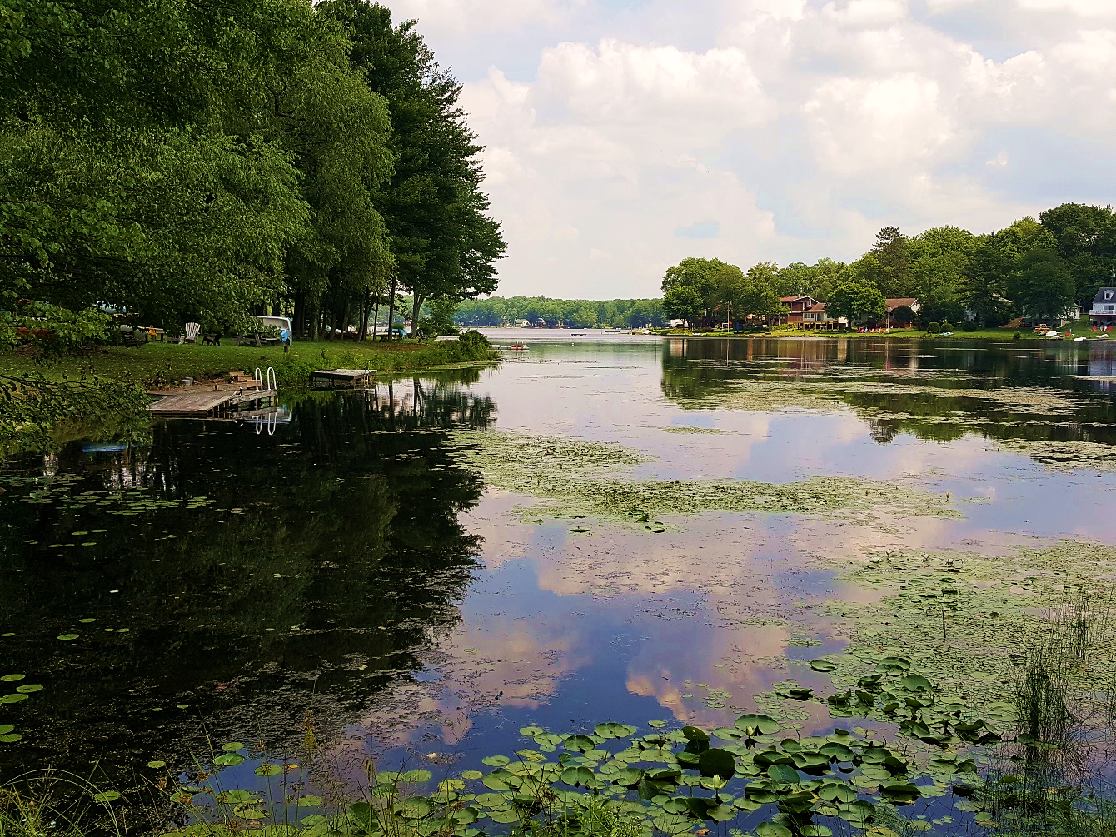
Penn Lake Protection Plan Protecting What is Present
Program by: John Levitsky, Watershed Specialist, Harvey’s Lake EAC

Slide 2
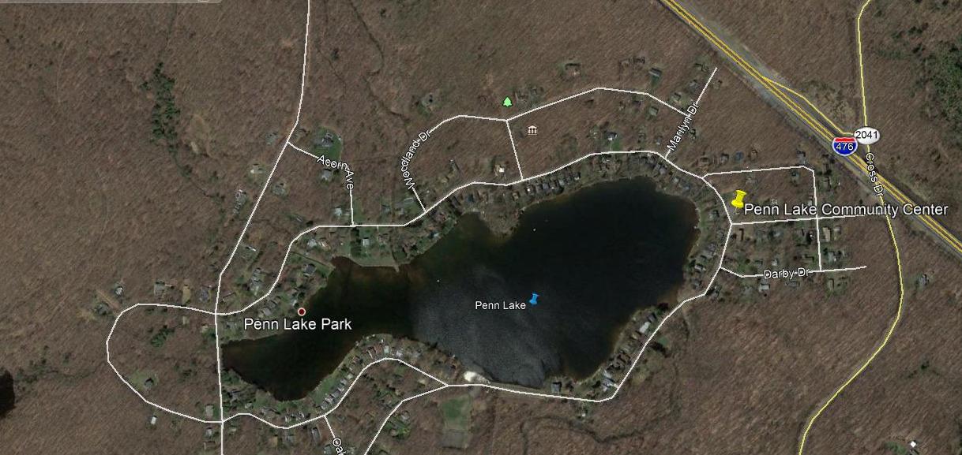
Lake Surface 55 acres, WS Area 4,467 acres, Average Depth 20 ft. Maximum Depth 27 ft. Penn Lake was developed for ice production and now supports esthetics, fishing, wildlife viewing, swimming & recreational non-motorized boating use.

Slide 3
What works to protect the Lake?
Minimize changes on the landscape and water
Maximize vegetative cover without use of fertilizers
Apply lime to lawn areas based on a soil pH from official sampling (Penn State Agronomy Labs available from LCD or Penn State Extension)
When mowing or weed wack operation blow cuttings away from the water
Stop all feeding of waterfowl
Clean up all animal excrement including pet waste near the Lake

Slide 4
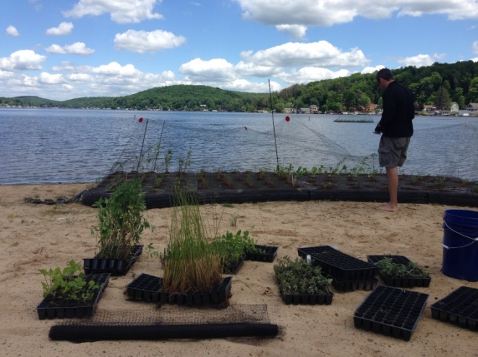
Examples of what Harveys Lake did to clean up the Lake:
Assisted consultant in identification of sediment source locations
Secured grants for BMPs to cleanup poor runoff areas
Initiated a phosphorus ban in lawn fertilizers with an ordinance 1997
Started licensing of lawn care professionals 1997
Reduced waterfowl feeding at the Lake through education 1998
Created an ordinance against feeding waterfowl 1999
Identify violations of Clean Streams Laws for education & enforcement
Secured vacuum truck to maintain sediment removal from BMPs
Established cooperation with nearby Municipalities for lawn waste recycling
Worked directly with consultant on floating wetland islands
Added Erosion & Sediment Control to Municipal building permits

Slide 5
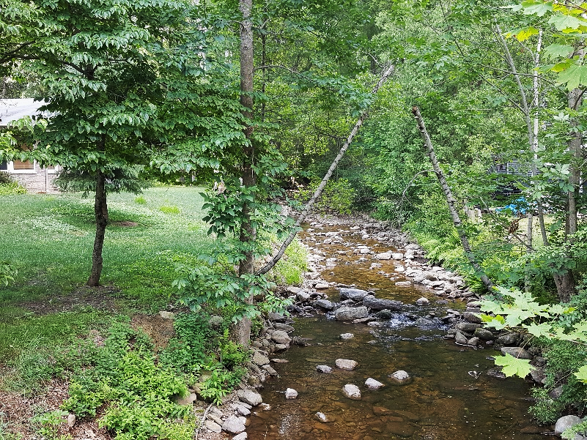
Positive points at Penn Lake in 2018 are:
You don’t have major water quality problems to address
Cautious corrections and protections are all that is needed
Don’t believe that doing little isn’t enough
The water entering the Lake from upstream is already in good quality, pH being the only real concern from acid rain
Upstream areas are protected by forest cover in State Game Lands and Nature Conservancy protected areas
We encourage expansion of permanently protected lands upstream of the Lake while discouraging land development near wetlands and streams within Penn Lake development as well as other locations upstream of Penn Lake
Work towards an increases in
vegetated buffers along the Lake
shores and protect buffers on streams
Plant rain gardens for roof and pave
runoff to adsorb contaminants
Plant native species along the Lakeshore
Allow Lakeshore vegetation to grow

Slide 6
Phosphorus Ban on Lawn Fertilizer Applications and Licensing of Lawn-Care Companies
Over use of Phosphorus Fertilizer can increase levels in the waterway. Harveys Lake EAC initiated a Phosphorus ban and mandatory licensing of commercial lawncare companies within Harvey’s Lake Borough
Local suppliers supported the initiative through calls from EAC committee members
Now national manufacturers and suppliers including Scotts and Ace Hardware are stepping up

Slide 7
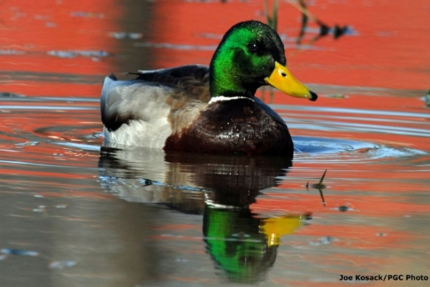
How Waterfowl Feeding at Harveys Lake was Minimized:
Identify number, species and concentration points from feeding of waterfowl using the Lake
Began discouraging people from feeding ducks and geese in newspapers and Municipal newsletter 1998
Purchased and installed signs at waterfowl feeding locations
Waterfowl Feeding ban established as an ordinance 1998
Wintering mallards dropped from 350 to 75 individuals in 1 year
Wintering Canada geese dropped from 140 to 40 individuals in 1 year
Reduced Phosphorus loading by ~5.5 lbs./day or 495 lbs. winter season
Penn Lake only needs to stop feeding within a small group.
Waterfowl will use the Lake eating native plants and will
leave when food becomes less available.
Nature recycles nutrients this way as the waste
from waterfowl feeds nutrients to plants they
Eat. Artificial foods are a direct nutrient input.

Slide 8
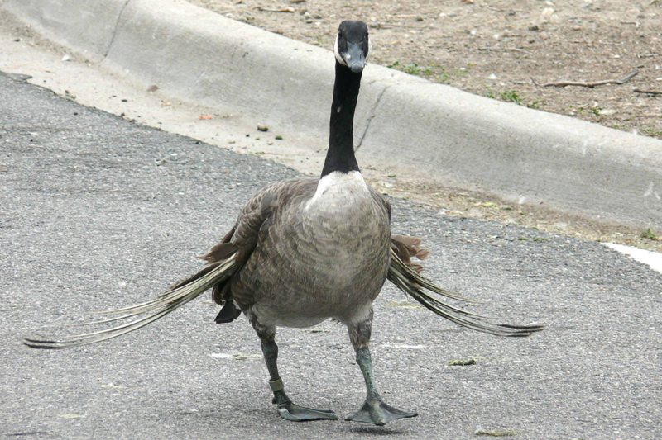
Common disagreements are, “I’m feeding waterfowl because I care about these birds”. Here are some concerns to think about:
Feeding can damage the birds. Angel wing picture of a goose from human introduced foods.
Elevated bacteria levels affecting the use of the lake for swimming and droppings on lawns, docks and beach.
Feeding can increase the probability of disease outbreaks in the local duck and goose population.
Feeding can increase predation of waterfowl from eagles, foxes and bobcats

Slide 9
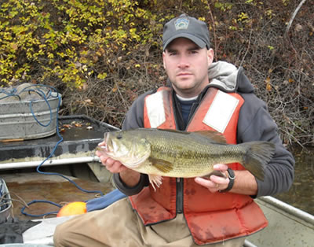
Trophy Fisheries Management Requires Food, Cover, Age-class and Reproduction
Trophy fish take time to grow, practice catch and release as much as possible. Implement protective regulations on trophy sized fish.
Protect woody and vegetation structures within the Lake to improve fish habitat. Some of the best summer fishing will be in lily pads.
Improve spawning areas for panfish and bass to fan out redd locations.
Do not stock adult fish in the existing population structure, improve what is present whenever possible.
Recognize that the fish population may still be recovering from the Lake drainage in 2008.

Slide 10
Lake Fisheries Balance
Adult Fish Stocking Impacts
On All Fish Populations
Size and Age of fish
Non-stocked natural reproduction waters population structure
Stocked Adult Fish
Create impacts
to small fish #s
Number of fish/aquatic life

Slide 11
NO GRASS CARP!!!!!!
Grass carp are parallel to a water cow eating all vegetation, good or bad
When they consume large quantities of vegetation the plants are no longer present to consume nutrients and supply oxygen and structure for fish
Grass carp excrement contains nutrients similar to cattle which can then create blooms of algae
Grass carp if not properly sterilized prior to release can reproduce exponentially until they destroy the Lake

Slide 12
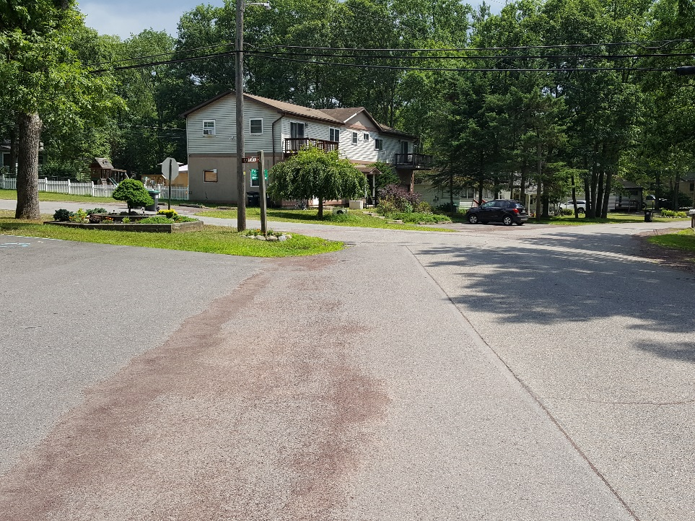
Due Diligence and Upkeep of Facilities
Encourage regulation and implementation of Erosion and Sediment Control plans from a Municipal stance through building permits, zoning officer, etc.
Conduct street sweeping to stop post winter anti-skid material from entering the Lake from the roads
Identify concerns and
forward information for
enforcement
Prepare an emergency
response plan for spills
Install rain gardens to trap
storm runoff from roof leaders
and paved areas
Minimize the use of lawn
fertilizers and increase the use
of lime on lawns to buffer acid
rain runoff

Slide 13
Lakeshore Planting Ideas and Concepts:
http://dec.vermont.gov/sites/dec/files/wsm/lakes/Lakewise/docs/lp_VTlakescape.pdf

Slide 14
Rain Garden Installations: Create locations to trap sediments and nutrients from storm runoff Increase absorption of water to the ground improving aquifer water quality and quantity Create beauty on your property while improving water quality to the Lake
Graphic from Snohomish Conservation District, Washington State

Slide 15
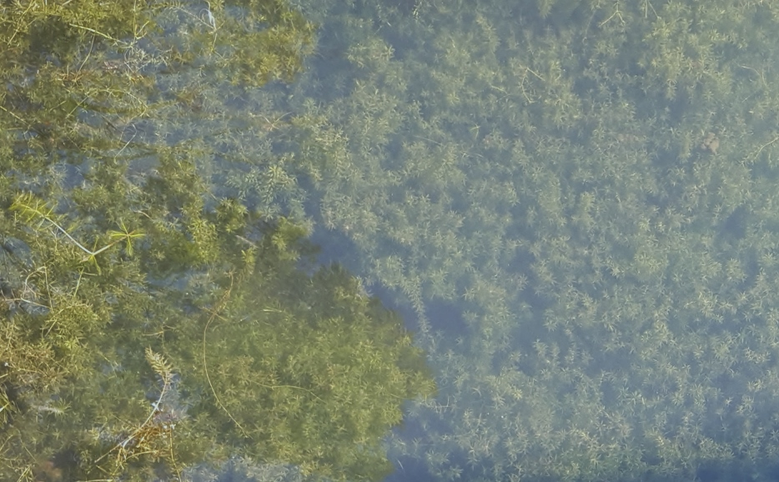
Protect from Invasive Species
Introduced Lily species
Introduced Hydrilla species
Wash all boats that are brought from other locations prior to using them
Dry all boats after the wash is complete
Clean all plant debris, mud, mollusk shells from boat trailers, boats & anchors
Introduced Zebra mussel

Slide 16
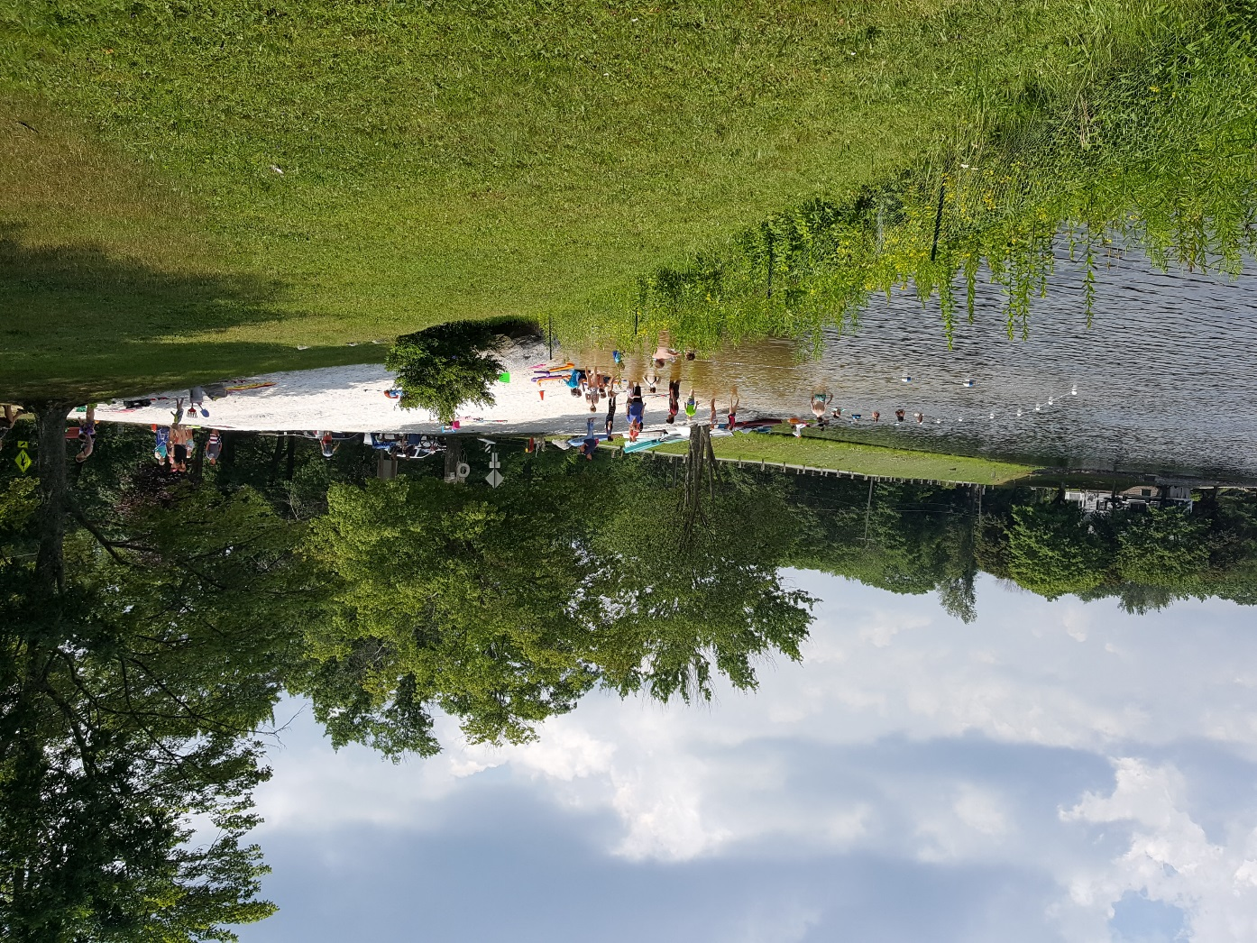
Lake water quality needs people as much as pollution needs people to create it!

Slide 17
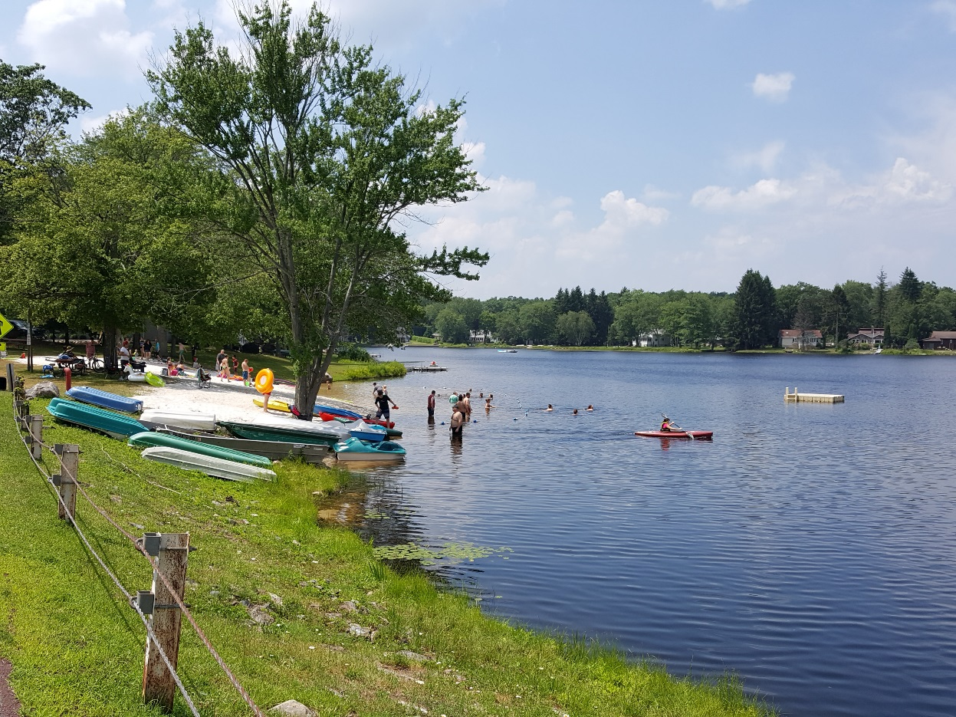
Clean Lake Communities Take Everyone’s Effort

